Slide 1
Bray Team Week 10 Update
Avery Haynes, Locke Lehmann, Travis Carlson, Cody Sims, Zachary Walker, Michael Hager
10/23/2023

Slide 2
Problem Statement Summary
Develop a method to internally measure valve position independent of an actuator, measure actuator output torque, and detect fluid leakage to increase the valve's service life.
Priorities: position and torque
Bray cares about all three, customers care about torque and leakage
Existing solution: IOT Torque Bracket

Slide 3
Week 9 Deliverables
Week 9 Tasks
Deliverable | Team Member | Percent Completed | Notes
Analyze the results of Brays concept review | All | 100%
Receive and look at final SolidWorks model | Zack | 70%
Schedule final presentation date | Zack | 0% | Still have not been able to meet due to bray being busy Hope to schedule it in today's meeting
Continue WBS and Gantt chart for 401/402 | Michael | 90%
Begin draft of DR2 report covering the concept generation aspects | Avery/Locke | 70% | Focused on getting all assignments like HOQ and charts up to date with the project
Quantitative Matrix | Cody/Travis | 80% | Finished preliminary matrix need to review the individual calculations done

Slide 4
Week 10 Plans
Week 10 Tasks
Deliverable | Team Member | Percent Completed | Notes
Design requirements and HOQ, Idea generation (analogy), Concept refinement | Locke | 20%
Functional Modeling, Idea Generation Morphological analysis, Concept refinement | Avery | 15%
Background research, Problem, Brainstorming, Concept selection, conclusions | Zach | 40%
Introduction, Scheduling and managing a project, Final deliverables, Formating | Michael | 15%
Customer Needs, TRIZ idea generation, Future Work | Travis | 10%
Executive Summary, Concept selection, Formatting | Cody | 5%

Slide 5
Feedback on concepts
Do not like the indirect measurement ideas.
Favorite concept is the potentiometer
Also like the magnet and compass but look into using a hall effect sensor.
Want higher importance placed on accuracy so should at least double its importance.

Slide 6
Narrowing Concepts
Using Pugh Chart results from last week narrowed down to our best 5 ideas to use for a quantitative matrix.
Selected concepts
Detecting magnetic field using a compass
Using variable voltage through a potentiometer (position)
Rotational torque sensor attached to stem
Potentiometer (torque)
Force sensor on stop bolts

Slide 7
Selection Criteria
Measurement Accuracy (% uncertainty from total)
Calibration Time (sec/min)
Cost ($)
Lifetime of sensor (years or cycles)
Volume of apparatus (in^3)
Weight of apparatus (lbs)
Ease of manufacturing (# of parts)
Ease of maintenance (# of moving parts)
Two concepts for position and three for torque were considered in the matrix

Slide 8
Concept Selection
Metrics | Importance | Magnet and Compass [Locke] | Potentiometer (valve position) [Travis] | Rotational Torque Bracket [Cody] | Potentiometer (torque) [Avery] | Force sensor on stop bolt [Zack]
Measurement Accuracy (% uncertainty from total) | 0.5 | 1.11% | 0.01% | 0.5 % | 2.00% | 3%
Calibration Time (sec/min) | 0.1 | 56.5 min | 80 min | 90 min | 30 min | 15 min
Cost ($) | 0.05 | $465.00 | $136.00 | $2,900.00 | $125.00 | $150.00 (would need 2)
Lifetime of sensor (years or cycles) | 0.1 | near-infinite | 50 million cycles | 100 million cycles | 1-20 million cycles | 1-10 million cycles
Volume of apparatus (in^3) | 0.05 | 5.235 | 32.35 | 5.88 | 8 | 5
Weight of apparatus (lbs) | 0.03 | 2 lbs | .5 lbs | 1.1 lbs | 2.5lb | 1
Ease of manufacturing (# of parts) | 0.1 | 4 | 2 | 5 | 2 | 3
Ease of maintenance (# of moving parts) | 0.07 | 0 | 1 | 2 | 1 | 0

Slide 9
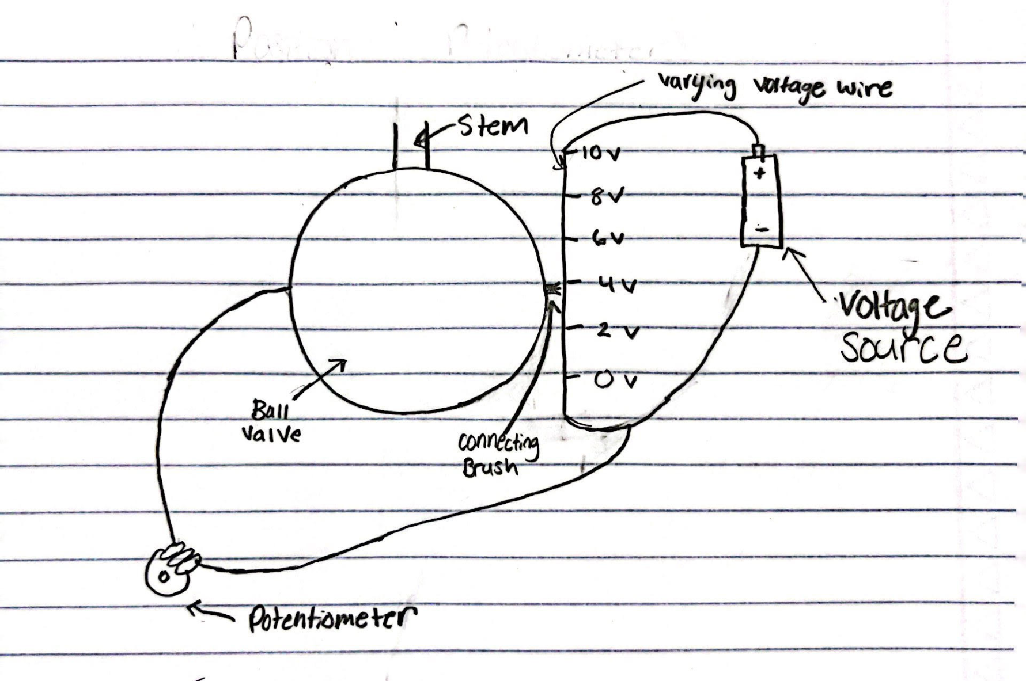
Concept Selection
Position Selection: Potentiometer

Slide 10
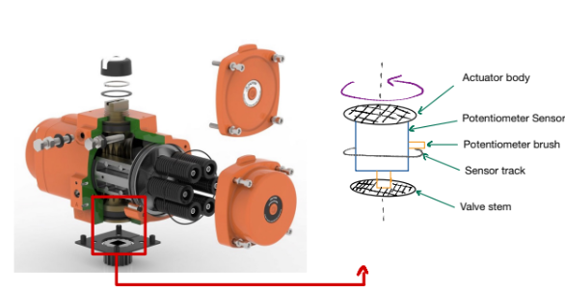
Concept Selection
Torque Selection: Potentiometer

Slide 11
Future Work / Next Steps
Will discuss thoughts on design concepts with Bray today after class
Write DR2 report this week; already have divided work
Focus on thinking of more details for selected concepts (leakage problem is pretty much being ignored by now)
Schedule final presentation date with Bray today

